Slide 1


How Evidence Can Power Your Work
Caroline Fiennes
www.giving-evidence.com
caroline.fiennes@giving-evidence.com
BlueSky: carolinefiennes. bsky .social

Slide 2
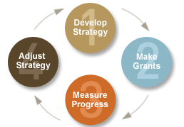
Before starting: needs assessment
Maintain
/ replicate
/ scale up
Pilot
Test:
Impact evaluation
What effects does this thing have?

Slide 3
Before starting:
Where & what are the problems?
Community view of the problem /solutions.
Shop for feasible interventions.
USE evidence, don’t necessarily
PRODUCE it
Is this approach likely to work / been found to work elsewhere?
Feasibility? In that context?
Acceptability?
Before starting: needs assessment
Maintain
/ replicate
/ scale up
Pilot
Test:
Impact evaluation
What effects does this thing have?

Slide 4
Monitoring / process evaluations:
Is it actually being delivered? In full, every time?
To the right people / badgers?
What does it cost?
How many people is it reaching?
What resources (time, money, people) does it take?
Feedback from intended beneficiaries
Before starting: needs assessment
Before starting: needs assessment
Maintain
/ replicate
/ scale up
Pilot
Maintain
/ replicate
/ scale up
Pilot
Pilot
Test:
Impact evaluation
What effects does this thing have?
Test:
Impact evaluation
What effects does this thing have?

Slide 5
Is this intervention, in this place:
Feasible (for us)
Affordable
Acceptable
Reaching the right people?
Before starting: needs assessment
Before starting: needs assessment
Maintain
/ replicate
/ scale up
Pilot
Maintain
/ replicate
/ scale up
Pilot
Test:
Impact evaluation
What effects does this thing have?
Test:
Impact evaluation
What effects does this thing have?

Slide 6
“Ask an important question and answer it reliably”
- Professor Sir Richard Peto
Before starting: needs assessment
Before starting: needs assessment
Maintain
/ replicate
/ scale up
Pilot
Maintain
/ replicate
/ scale up
Pilot
Pilot
Test:
Impact evaluation
What effect/s does this thing have?
Test:
Impact evaluation
What effects does this thing have?
Test:
Impact evaluation
What effects does this thing have?

Slide 7
Monitoring:
are you getting the expected results?
Process evaluations:
is it actually being delivered? Is the targeting working – are we serving the people we intended?
Feedback
Before starting: needs assessment
Before starting: needs assessment
Maintain
/ replicate
/ scale up
Maintain
/ replicate
/ scale up
Maintain
/ replicate
/ scale up
Pilot
Test:
Impact evaluation
What effects does this thing have?
Test:
Impact evaluation
What effects does this thing have?

Slide 8
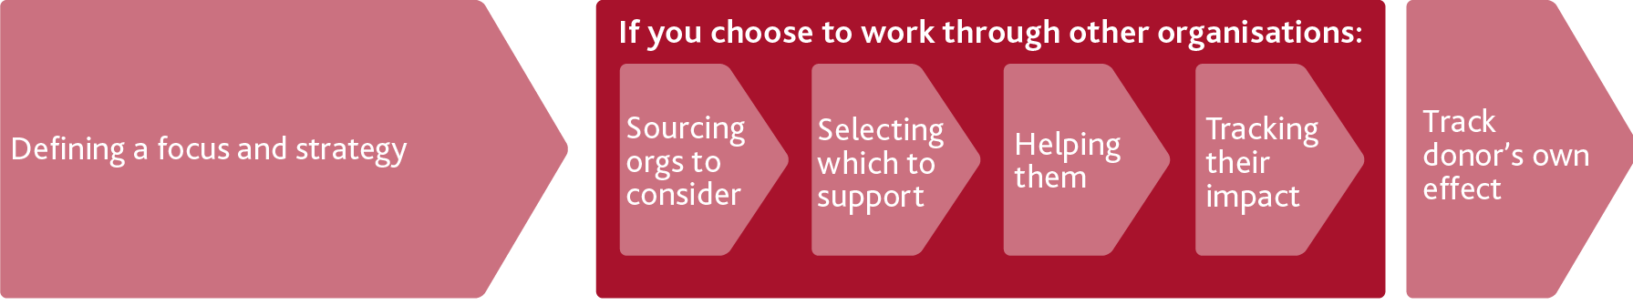
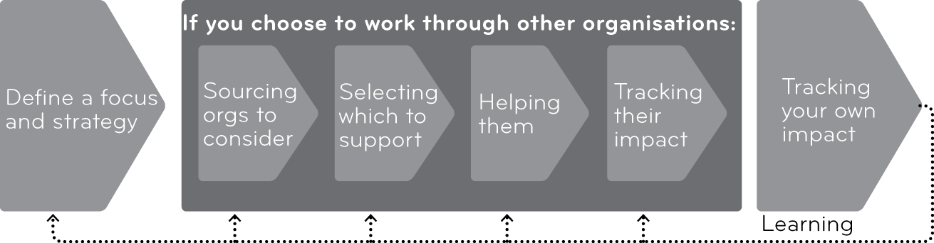
A funder’s process, in outline:
There are often several stages / committees in the funding decision

Slide 9

USE evidence, don’t always PRODUCE it fresh
For funders:
  Accept evidence & evaluations from elsewhere
  Don’t ask operational orgs to evaluate themselves
  Avoid requiring or incentivising production of unreliable or unimportant research
  Ensure that your org has the right research / evidence and skills in each stage of your work flow

Slide 10
How Evidence Can Power Your Work
Caroline Fiennes
www.giving-evidence.com ( /book2 )
caroline.fiennes@giving-evidence.com
BlueSky: carolinefiennes. bsky .social
References! will be on here (inshallah)

