Slide 1
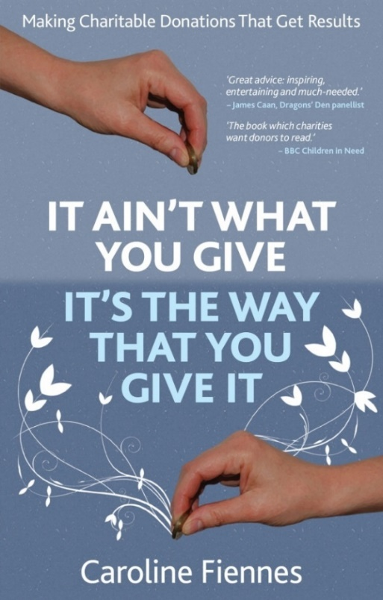

How Funders and Charities Use Evidence – In Their Various Complex Systems
Caroline Fiennes
Director, Giving Evidence
www.giving-evidence.com
caroline.fiennes@giving-evidence.com
BlueSky: @carolinefiennes.bsky.social

Slide 2
Often research / evidence is fundamentally aimed around behaviour change

Slide 3
Whose decision/s does evidence need to influence? - types of funder
Statutory funders, e.g., gov’t funds, national research councils
Charitable foundations
Companies (corp giving programmes / corp fdns)
Individuals incl. HNWIs
Almost always involve staff.
Decisions may be staff /board / ministers
Some are staffed
Some are staffed
Some are unstaffed
Some are unstaffed
Almost never involve staff
(unless they’re a fnd in which case they’re in the box to the left)

Slide 4
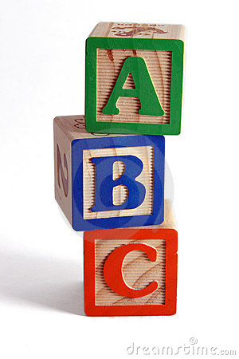
Find an important question: where more (good) research could make a difference
Answer it (well)
Help people to understand and use the answer

Slide 5
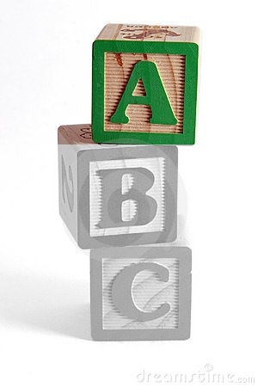
Find an important question: where more (good) research could make a difference
Answer it (well)
Help people to understand and use the answer

Slide 6
Barriers to evidence-based practice include:
ignorance
inertia
ideology
incentives
interests
decision-rights

Slide 7
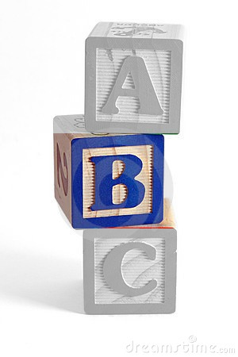
Find an important question: where more (good) research could make a difference
Answer it (well)
Help people to understand and use the answer

Slide 8
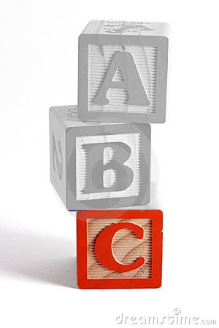
Find an important question: where more (good) research could make a difference
Answer it (well)
Help people to understand and use the answer:
Discoverability
Practical info incl. cost
Use, rather than (always) detailed knowledge

Slide 9
Find an important question: where more (good) research could make a difference
Answer it (well)
Discoverability
Practical info incl. cost
Use, rather than (always) detailed knowledge

Slide 10
Ways that evidence can seep into practice:
Instrumental: direct decision changes
Conceptual: changing how people think
Symbolic: citing an evaluation to legitimise a decision
Process use: involvement in evaluation itself changes culture

Slide 11
The daunting realization is that we don’t know what the hell we’re doing in most fields of life,
especially the ones that involve people
- Nobel Laureate Richard Thaler
Source: The Anti-Poverty Experiment, Wall Street Journal, 5 June 2015

Slide 12
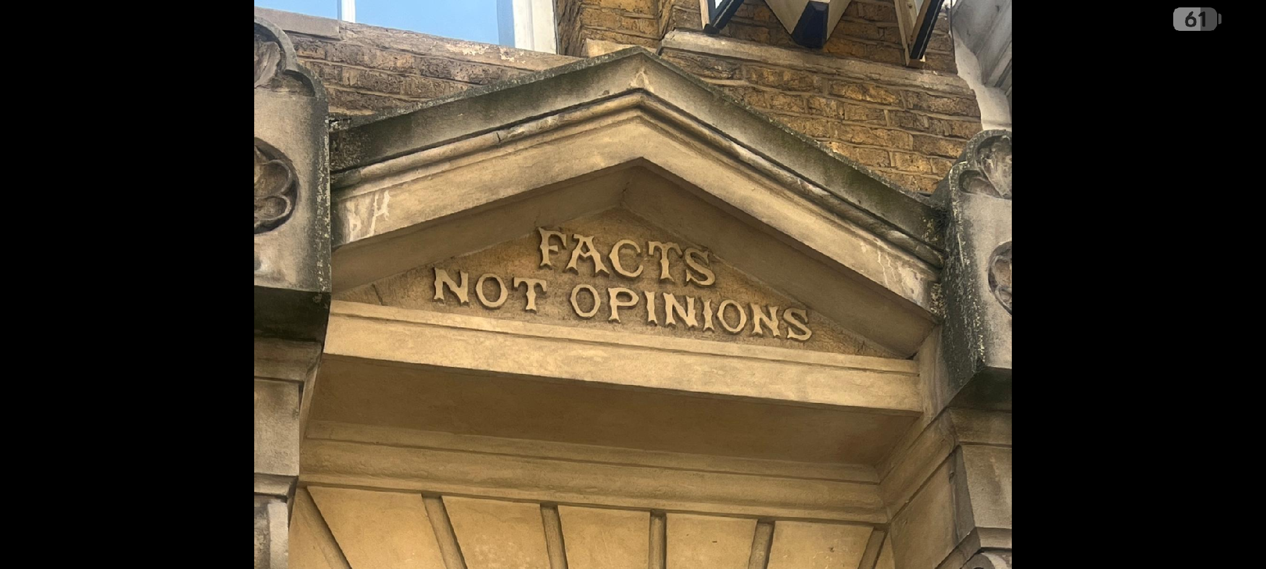
Doorway over the Kirkaldy Testing Works in Southwark, London

Slide 13
How Funders and Charities Use Evidence – In Their Various Complex Systems
Caroline Fiennes
Director, Giving Evidence
References: www.giving-evidence.com/ghana
caroline.fiennes@giving-evidence.com
BlueSky: @carolinefiennes.bsky.social

